Slide 1
Big Data Architecture and Governance
Group Project | Team 4
Nandita Patil
Shweta Wakale
Siddharth Natekar

Slide 2
Introduction to Airbnb
Airbnb, Inc., based in San Francisco, California, operates an online marketplace focused on short-term homestays and experiences.
The rating and review system is very important to the Airbnb platform. Ratings give prospective guests a way to evaluate a listing. For hosts, ratings impact things like search ranking on the platform and ultimately, occupancy and revenue.
Airbnb.org has helped 100,000 people fleeing the war find places to stay.

Slide 3
Project Objectives
To clean and validate the data extracted from Airbnb Dataset
Create a data model for the given dataset
Create a database in Neo4j and load the dataset using Cypher queries
Using JDBC Connector, Connect Neo4j to Tableau
Build an interactive dashboard for better insights
Integration and Acceptance testing for data validation

Slide 4
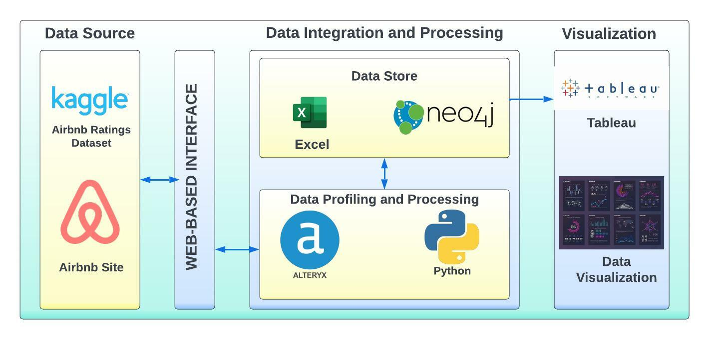
Vision Diagram

Slide 5
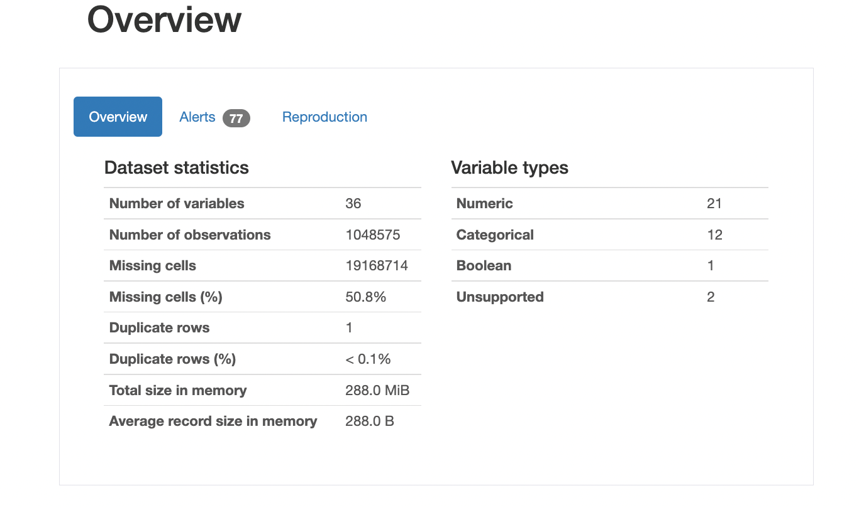
Data Profiling
Pandas Profiling
Pandas profiling is an open-source Python module with which we can quickly do an exploratory data analysis with just a few lines of code

Slide 6
Observations
From the overview, we can analyze that the dataset has 293694 records
The dataset has 36 variables
The Dataset has: 12 Categorical values
2 Unsupported 21 Numerical values
1 Boolean value

Slide 7
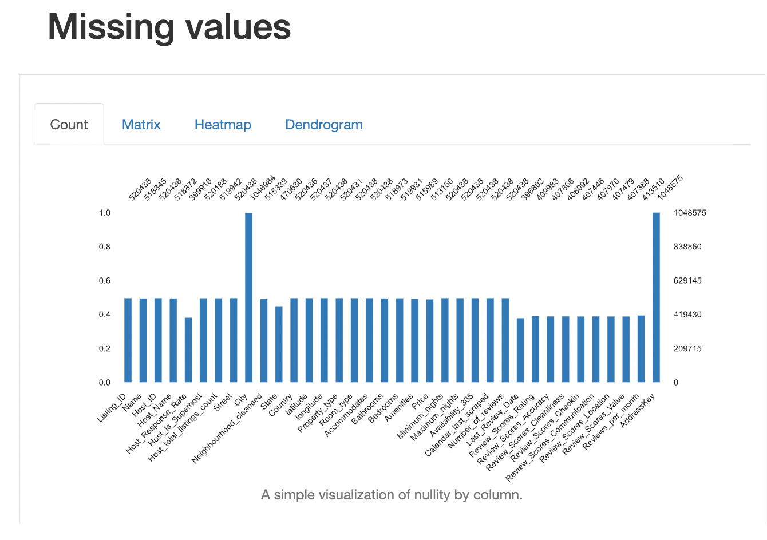
Data Profiling – Missing Values
Percentage of Missing values in the columns selected for analysis
For handling Missing values in the dataset for selected columns, we have replaced them with a value NA,0

Slide 8
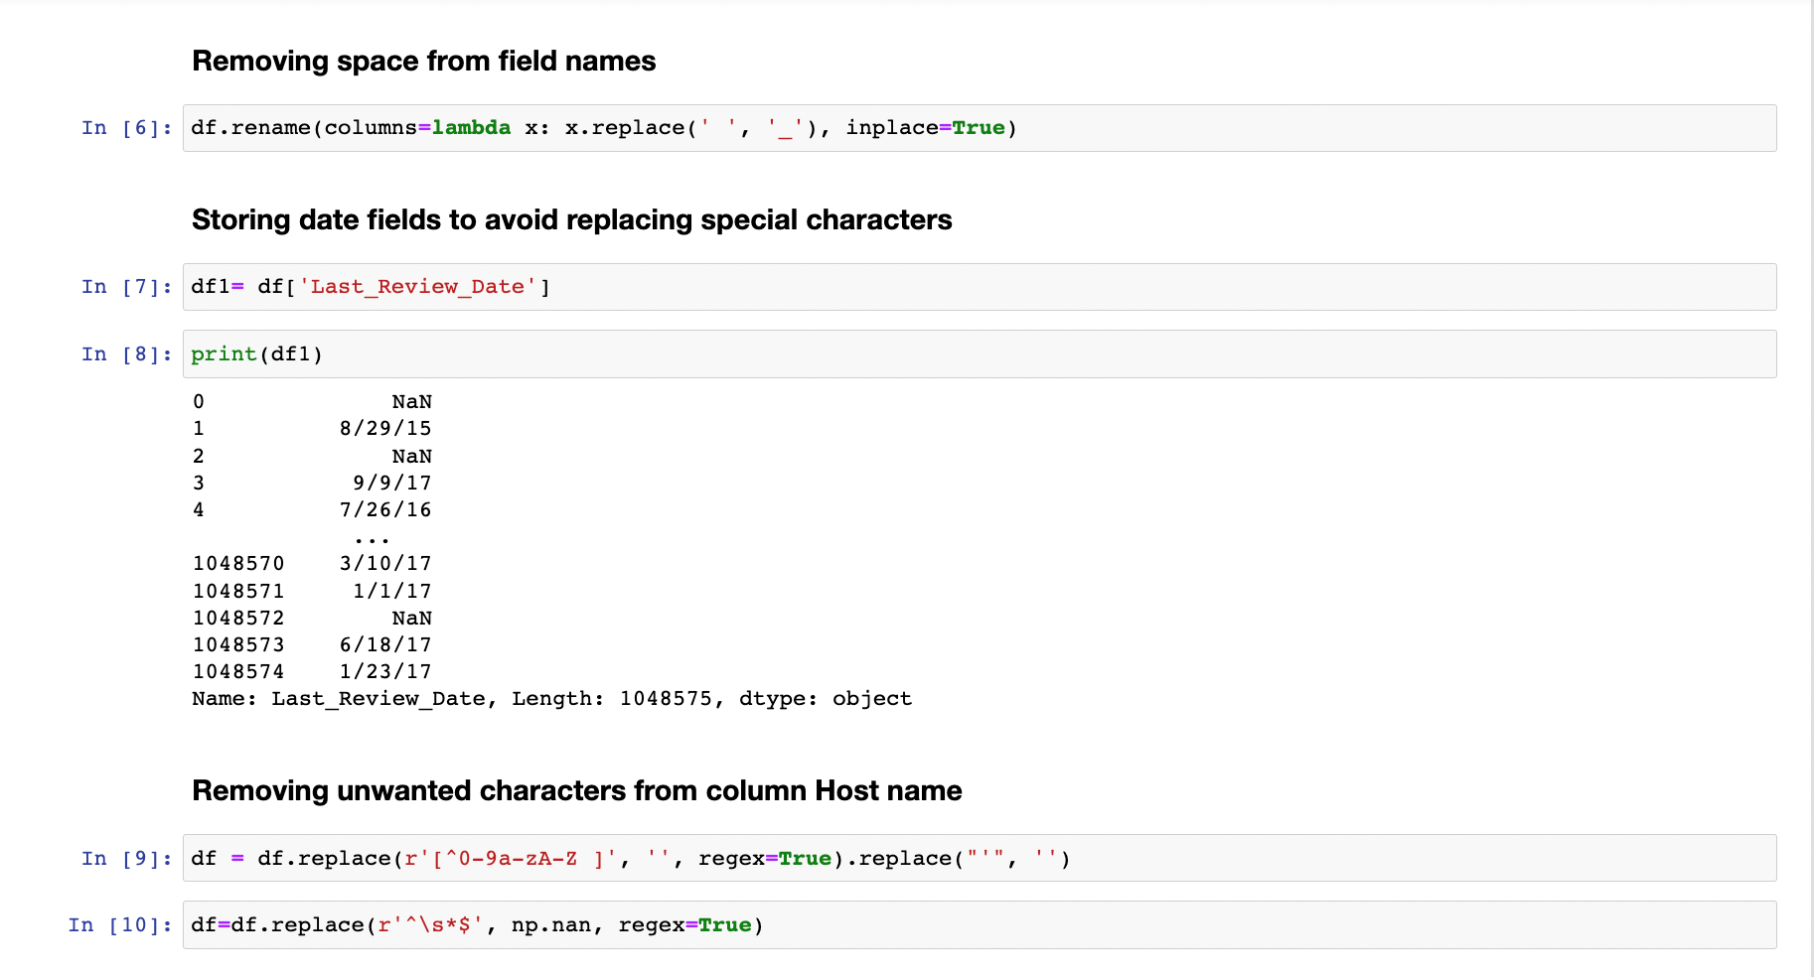
Data Preprocessing - Python

Slide 9
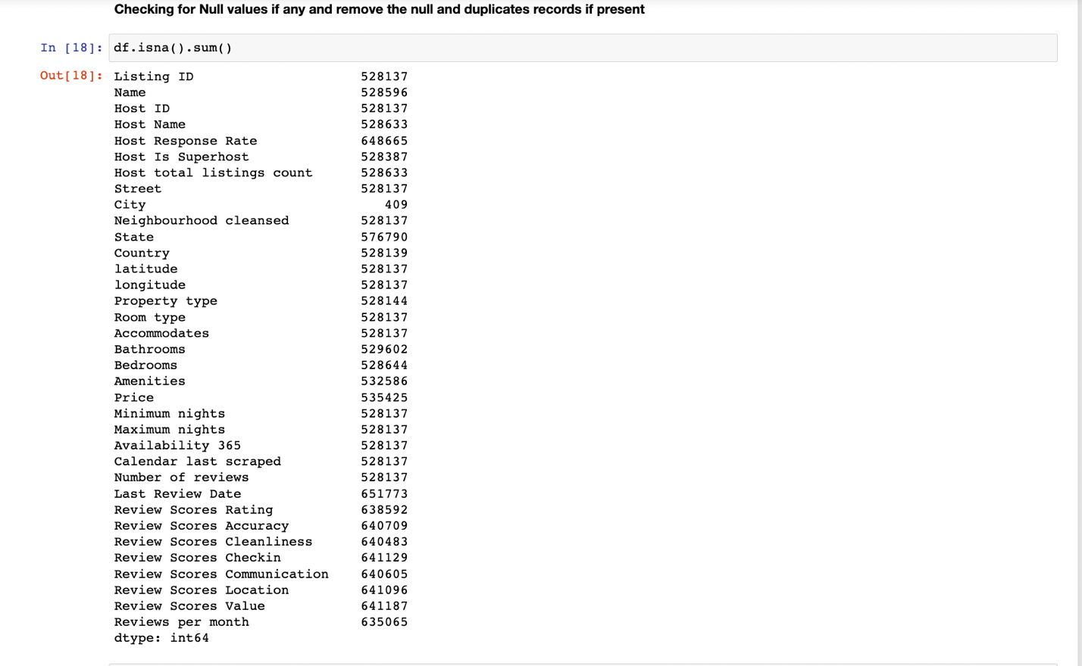
Data Preprocessing - Python
Checking and removing null and duplicate values

Slide 10
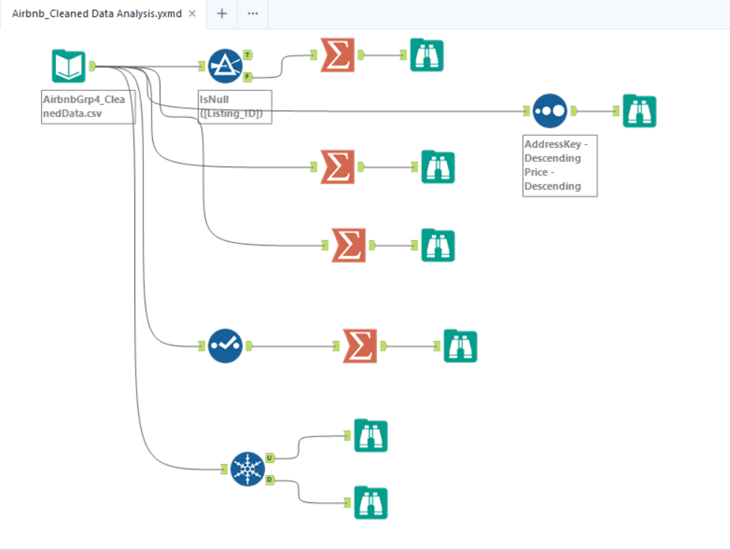
Data Preprocessing - Alteryx
Alteryx Workflow for Cleaning the dataset which includes removing blank spaces, extra commas, and capitalization.

Slide 11
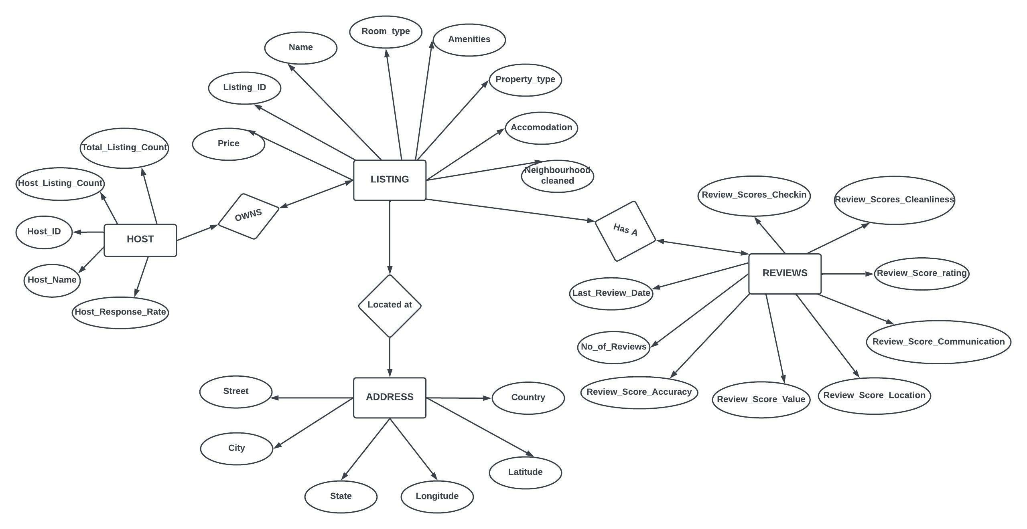
Data Model

Slide 12
Database - Neo4j
Neo4j Database
The Neo4j database is a graph database and is used to represent the data in the form of graphs. It offers data integrity and is ACID (Atomic, Consistent,Isolated,Durable) compliant. Just like RDBMS has a language called SQL to access data, the Graph database has a language called Cypher
Neo4j can be download by clicking on the link Download Neo4j
Starting the Server using Neo4j Desktop
To start using Neo4j database, open the Neo4j Desktop installed on the system.
Click on NEW to create a Project.
Now, create a database by clicking the “Add” button and set a password for your database. It is
also possible to change the password by going into the administration tab and setting a new
password. Add all the relevant files related to the database in the files section.

Slide 13
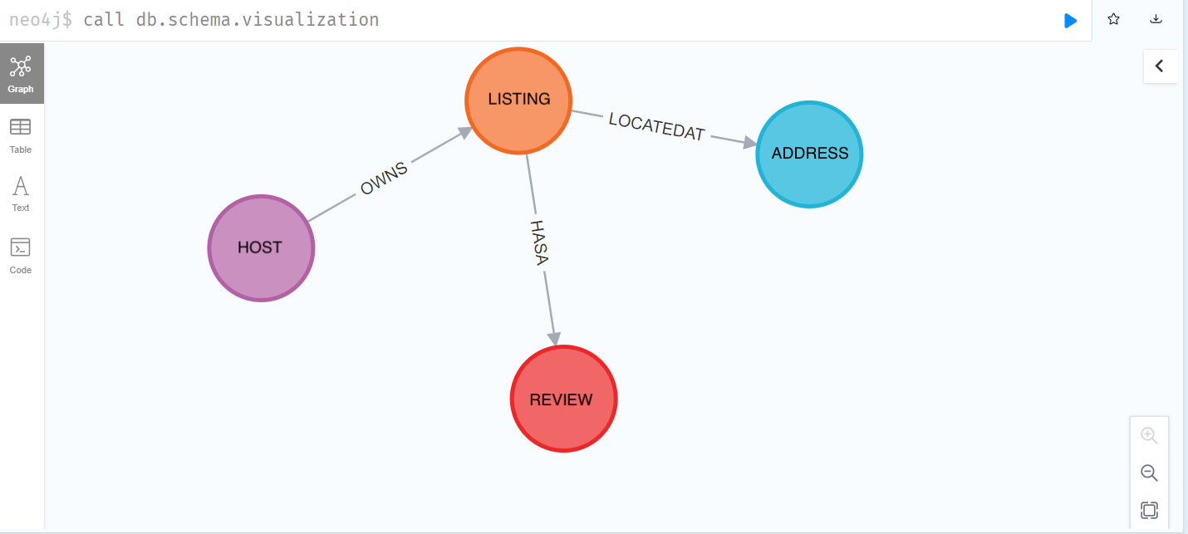
Database Schema in Neo4j

Slide 14
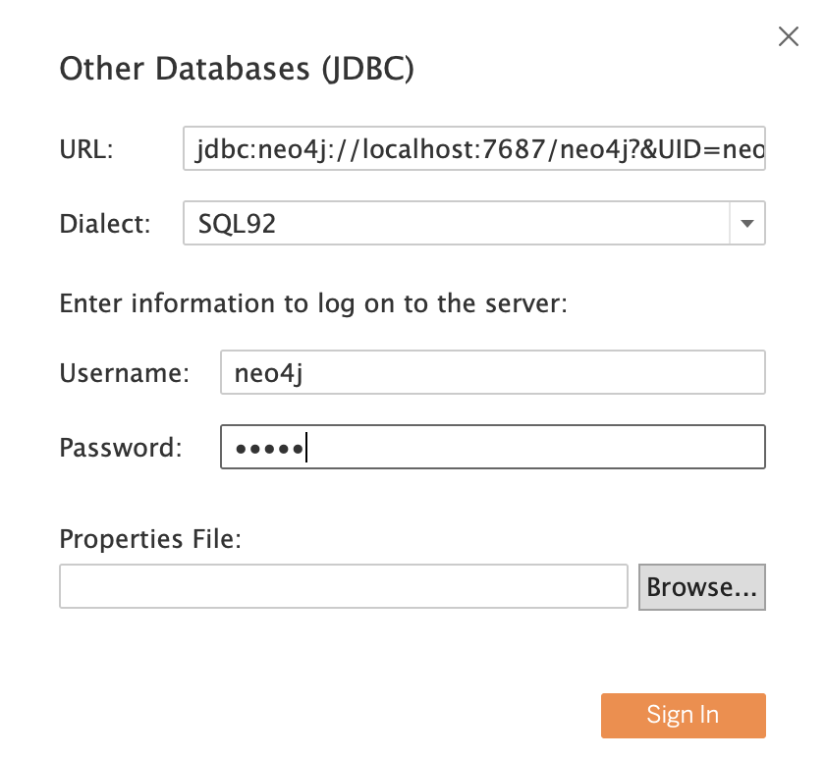
Connecting Neo4j to Tableau

Slide 15
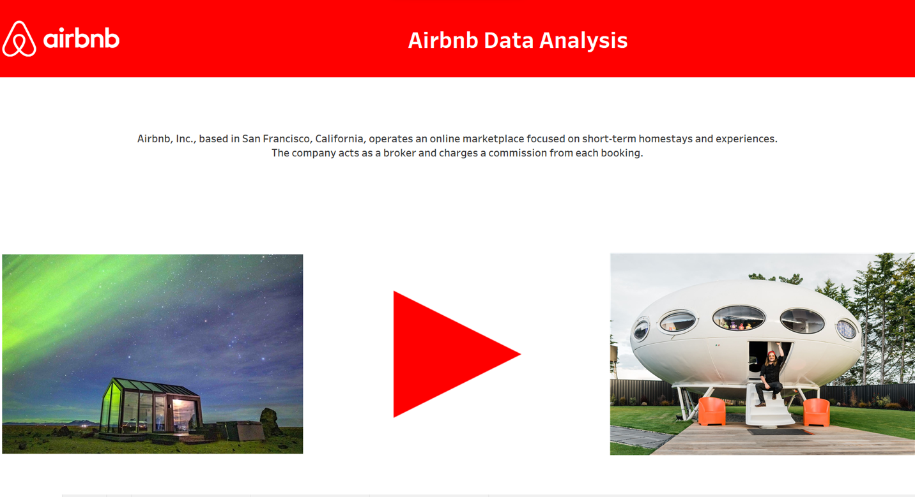
Data Visualization - Dashboard

Slide 16
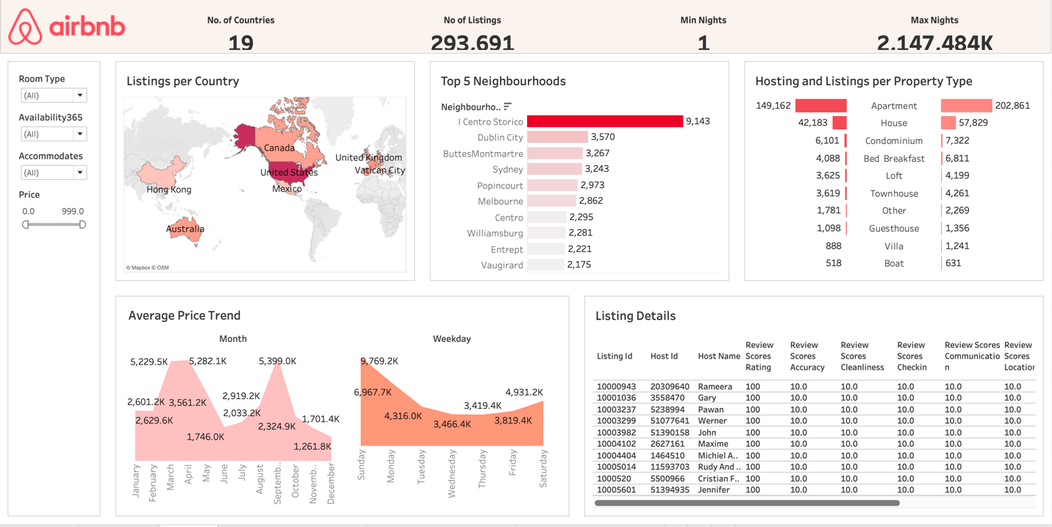
Dashboard

Slide 17
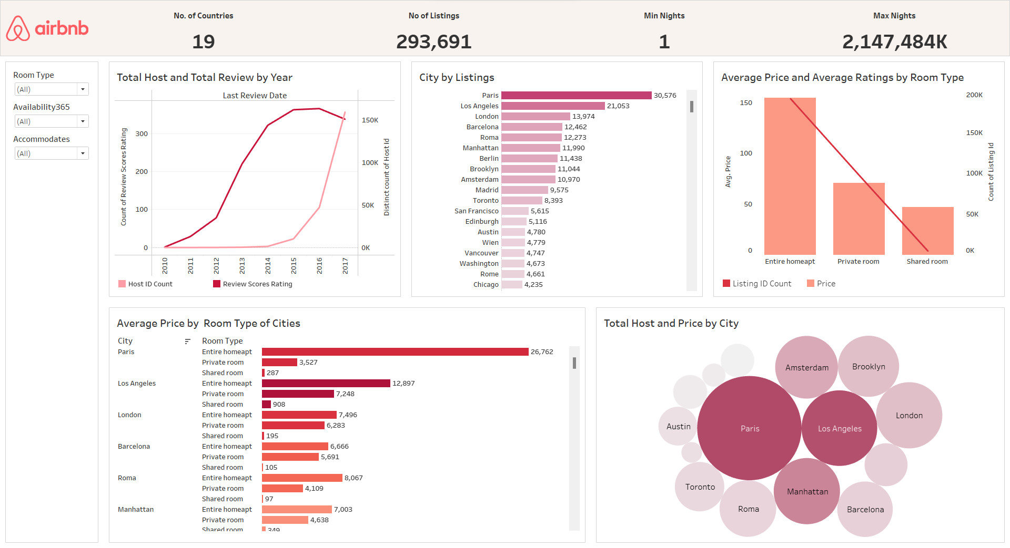
Dashboard Insights

Slide 18
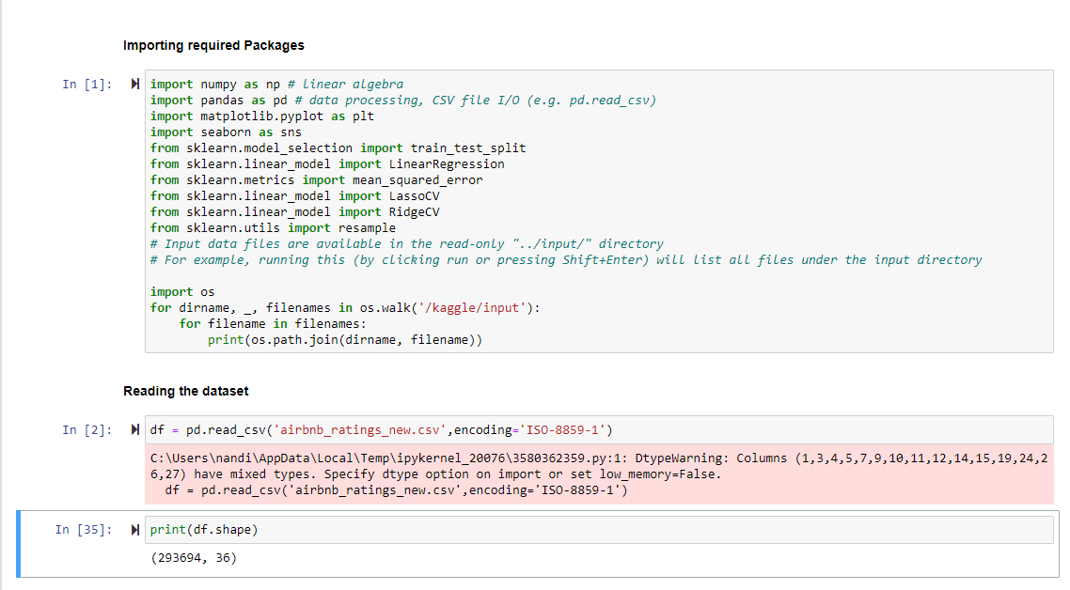
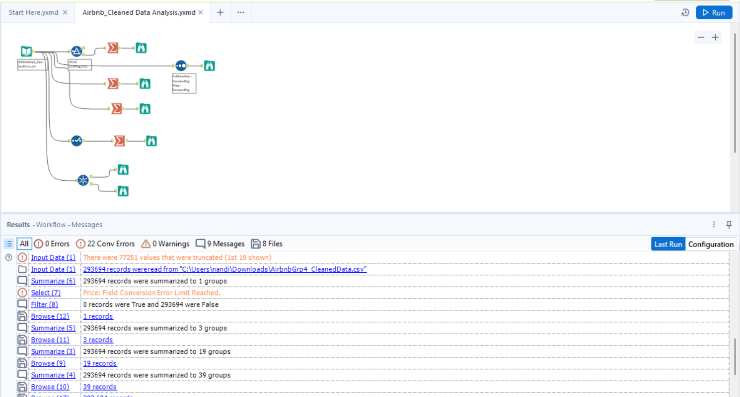
Data Validation
Validating the number of records after every process
Number of records
Number of records after preprocessing in Tableau
Number of records after processing the data using Alteryx

Slide 19
Thank you

